Slide 1
Java Polymorphism

Slide 2
Polymorphism means "many forms", and it occurs when we have many classes that are related to each other by inheritance.
Inheritance lets us inherit attributes and methods from another class. Polymorphism uses those methods to perform different tasks. This allows us to perform a single action in different ways.

Slide 3
Interface in Java

Slide 4
Java Interface also represents the IS-A relationship.
It cannot be instantiated just like the abstract class.
Since Java 8, we can have default and static methods in an interface.
Since Java 9, we can have private methods in an interface.

Slide 5
Why use Java interface?
There are mainly three reasons to use interface. They are given below.
It is used to achieve abstraction.
By interface, we can support the functionality of multiple inheritance.
It can be used to achieve loose coupling.

Slide 6
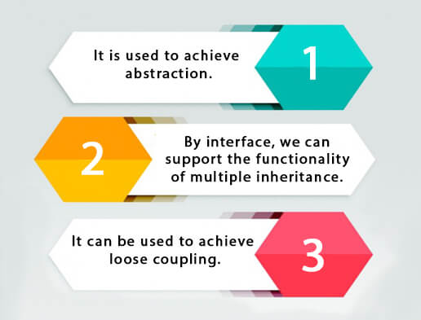

Slide 7
How to declare an interface?

Slide 8
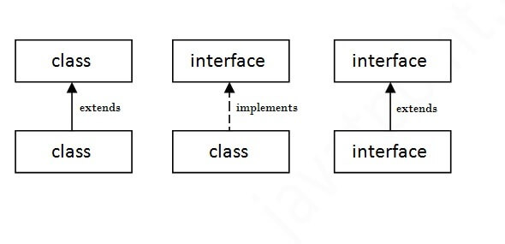

Slide 9
Multiple inheritance in Java by interface

Slide 10
Java 8 Default Method in Interface

Slide 11
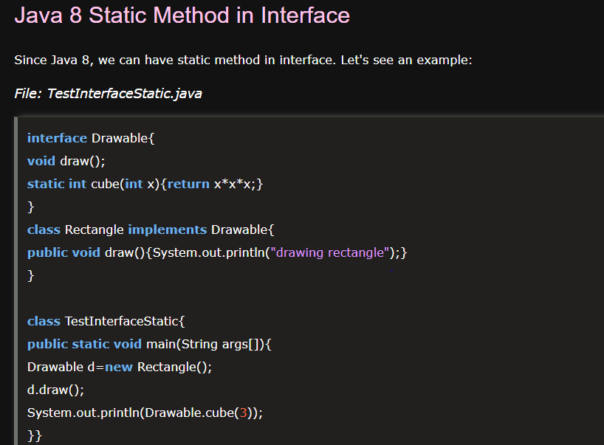

Slide 12
What is marker or tagged interface?
An interface which has no member is known as a marker or tagged interface, for example, Serializable, Cloneable, Remote, etc. They are used to provide some essential information to the JVM so that JVM may perform some useful operation.

Slide 13
Method Overriding in Java

Slide 14
Usage of Java Method Overriding
Method overriding is used to provide the specific implementation of a
method which is already provided by its superclass.
Method overriding is used for runtime polymorphism

Slide 15
Rules for Java Method Overriding
The method must have the same name as in the parent class
The method must have the same parameter as in the parent class.
There must be an IS-A relationship (inheritance).

Slide 16
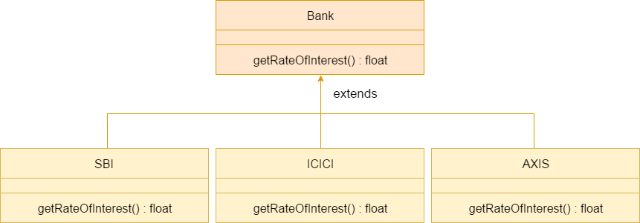

Slide 17
Java Inner Classes

Slide 18
class OuterClass {
int x = 10;
class InnerClass {
int y = 5;
}
}
public class Main {
public static void main(String[] args) {
OuterClass myOuter = new OuterClass();
OuterClass.InnerClass myInner = myOuter.new InnerClass();
System.out.println(myInner.y + myOuter.x);
}
}
// Outputs 15 (5 + 10)

Slide 19
Private Inner Class
Unlike a "regular" class, an inner class can be private or protected. If you don't want outside objects to access the inner class, declare the class as private:

Slide 20
Static Inner Class
An inner class can also be static, which means that you can access it without creating an object of the outer class:

Slide 21
class OuterClass {
int x = 10;
static class InnerClass {
int y = 5;
}
}
public class Main {
public static void main(String[] args) {
OuterClass.InnerClass myInner = new OuterClass.InnerClass();
System.out.println(myInner.y);
}
}
// Outputs 5

Slide 22
